Slide 1
Data Manipulation with Pandas
PANDAS

Slide 2
Data Manipulation with Pandas (2)
Combining Datasets: Concat and Append
Combining Datasets: Merge and Join
Aggregation and Grouping
Pivot Tables
Visualize data with pandas

Slide 3
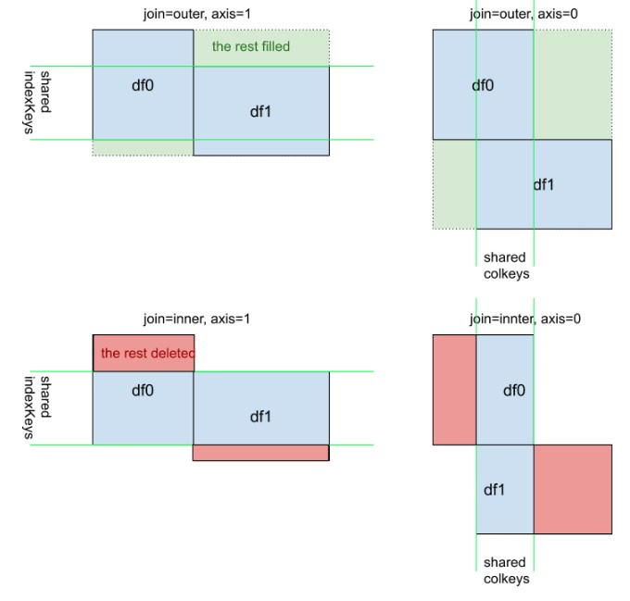
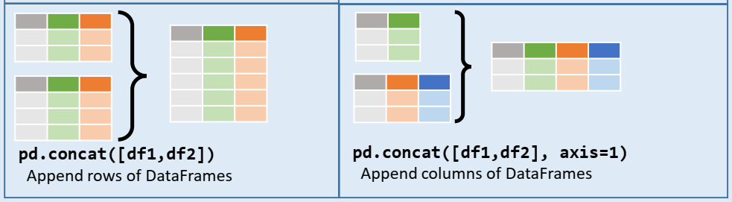
Combining Datasets: Concat and Append
Concatenation
pd.concat(objs,
axis=0,
join='outer',
join_axes=None,
ignore_index=False,
keys=None,
levels=None,
names=None,
verify_integrity=False,
copy=True)
Objs: a sequence or mapping of Series or DataFrame objects. Ex: [df1,df2]
Axis: {0/’index’, 1/’columns’}, default 0
Join: {‘inner’, ‘outer’}, default ‘outer’
Practice
df1 = pd.DataFrame([['a', 1], ['b', 2]],
columns=['letter', 'number'])
df2 = pd.DataFrame([['c', 3, 'cat'], ['d', 4, 'dog']],
columns=['letter', 'number', 'animal'])

Slide 4
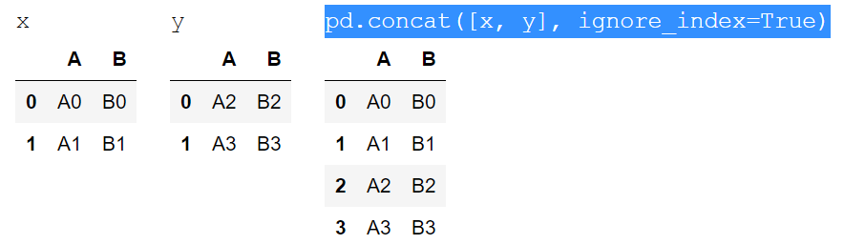
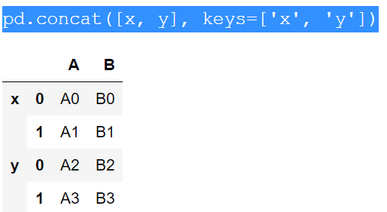
Combining Datasets: Concat and Append
Ignoring the index
Adding MultiIndex keys

Slide 5
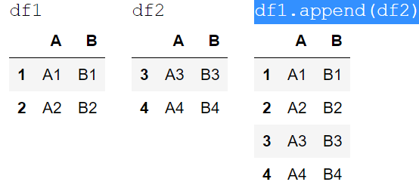
Combining Datasets: Concat and Append
The append() method is a simple for pd.concat()
df1.append(df2) ~ pd.concat([df1, df2], ignore_index=True)

Slide 6
Practice

Slide 7
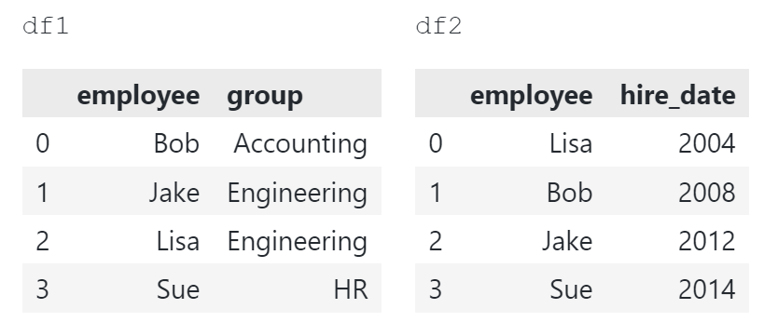
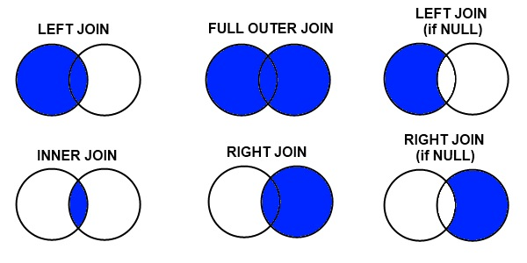
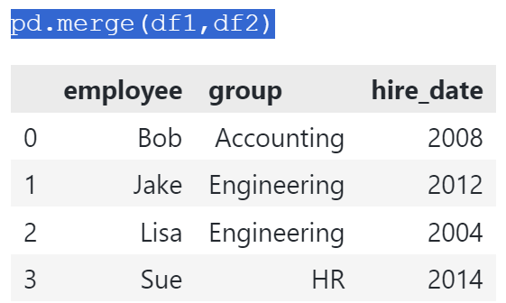
Combining Datasets: Merge and Join
Categories of Joins
The merge() implements common SQL style joining operations.
one-to-one:
many-to-one:
many-to-many
pandas.merge(left, right,
how='inner',
on=None,
left_on=None,
right_on=None,
left_index=False,
right_index=False,...)

Slide 8
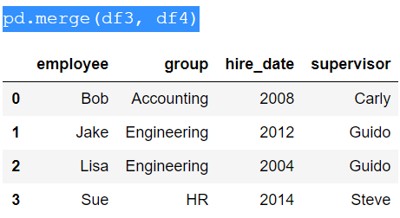
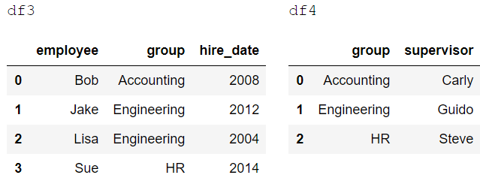
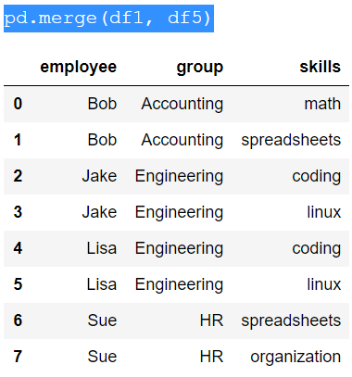
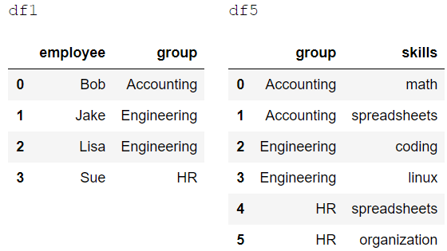
Combining Datasets: Merge and Join
Many-to-one joins
Many-to-many joins

Slide 9
Practice: US States Data
url1 = 'https://raw.githubusercontent.com/jakevdp/data-USstates/master/state-population.csv'
url2 = 'https://raw.githubusercontent.com/jakevdp/data-USstates/master/state-areas.csv'
url3 = 'https://raw.githubusercontent.com/jakevdp/data-USstates/master/state-abbrevs.csv’
pop = pd.read_csv(url1)
areas = pd.read_csv(url2)
abbrevs = pd.read_csv(url3)
Objective: Calculate and rank U.S. states and territories by 2010 population density.

Slide 10
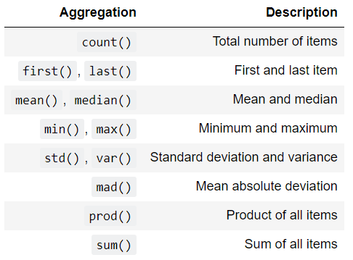
Aggregation and Grouping
Simple Aggregation in Pandas
Methods like sum(), mean(), and count() can be directly applied to DataFrames.
Table summarizes some other built-in Pandas aggregations

Slide 11
Practice
import seaborn as sns
planets = sns.load_dataset('planets')
planets.head()
Các cột chính trong bộ dữ liệu:
method: Phương pháp được sử dụng để phát hiện hành tinh.
number: Số lượng hành tinh được phát hiện trong mỗi hệ thống hành tinh.
orbital_period: Thời gian quỹ đạo của hành tinh (tính bằng ngày).
mass: Khối lượng của hành tinh (tính bằng khối lượng của Sao Mộc).
distance: Khoảng cách từ Trái Đất đến hành tinh (tính bằng parsec).
year: Năm phát hiện hành tinh.
Question:
What is the total number of planets discovered?
What is the average orbital period of the discovered planets?
How many unique methods were used to discover the planets?
What is the maximum mass of the discovered planets?
What is the minimum distance of the discovered planets from Earth?

Slide 12
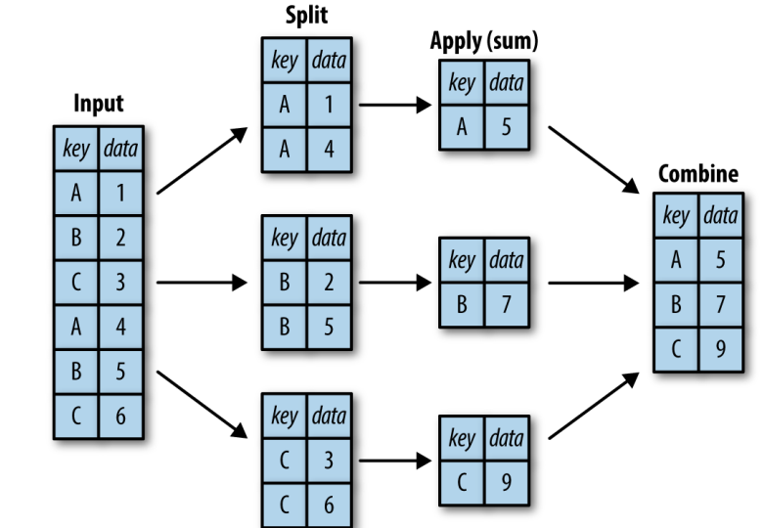
Aggregation and Grouping
GroupBy: Split, Apply, Combine
The groupby() method splits the data into groups, applies a function to each group, and combines the results. This is known as the "split-apply-combine" strategy.
Practice
df = pd.DataFrame({'key': list("ABCABC"),
"data":range(6)},
columns=['key','data'])
The key should be the category or discrete
df.groupby('key’).sum()

Slide 13
Aggregation and Grouping
Aggregate, filter, transform, apply
Aggregation
We're now familiar with GroupBy aggregations with sum(), median(), and the like, but the aggregate() method allows for even more flexibility.
Practcie
df = pd.DataFrame({'key': list("ABCABC"),
"data1":range(6),
'data2':range(6,12)},
columns=['key','data1','data2'])
def myfunc(x):
return x.sum()//2
df.groupby('key').aggregate(['sum','min',myfunc])
df.groupby('key').aggregate({'data1':['sum','min'],'data2':myfunc})

Slide 14
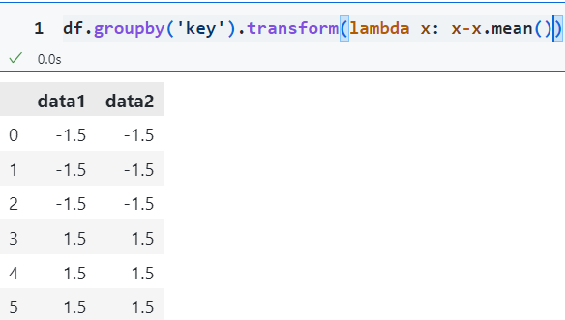
Aggregation and Grouping
Filtering
A filtering operation allows you to drop data based on the group properties.
Let's look at the following codes and explain how filters work
df.groupby('key').sum()
df.groupby('key').filter(lambda x: x.data1.sum()>=5)
Transformation
Applies a function to each group and returns an object with the same size as the original group. Often used for normalization or data transformation.

Slide 15
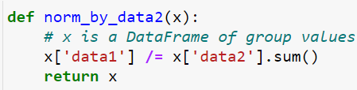
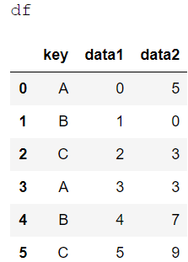
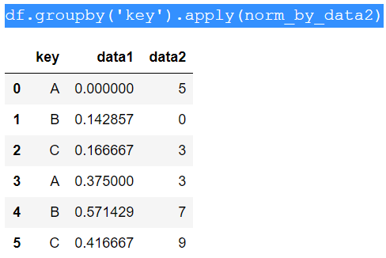
Aggregation and Grouping
The apply() method
Applies an arbitrary function to each group and can return an object with a different shape than the original group.
Summary
Aggregate (agg): Apply multiple aggregation functions on group columns.
Filter: Filter groups based on a condition.
Transform: Apply a function to each group, returning an object of the same size.
Apply: Apply an arbitrary function to each group, returning an object with a potentially different shape.

Slide 16
Practice
import seaborn as sns
planets = sns.load_dataset('planets')
Practice Requirements
Handling missing data
Using describe() method
Calculate the total number of planets discovered by each method.
Calculate the average orbital period of planets for each discovery method.
Determine the maximum mass of planets discovered by each method.
Calculate the average distance from Earth to the planets discovered each year.
Count the number of planet discoveries by each method and year.
Aggregate the total number of planets and average mass by each method.
Filter methods of discovery that have discovered more than 20 planets in total.
Apply a custom function to calculate the average mass of planets if the number of planets is greater than 1 within the group.

Slide 17
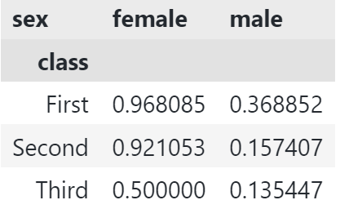
Pivot Tables
Motivating Pivot Tables
import numpy as np
import pandas as pd
import seaborn as sns
titanic = sns.load_dataset('titanic')
titanic.head()
To get a deeper look at survival rates by both gender and ticket class, we can use a long and complex code string:
titanic.groupby(['class','sex'])['survived'].mean().unstack()
Pandas provides the pivot_table method to simplify ultidimensional aggregation
pd.pivot_table(data=titanic,index='class’,
columns='sex', values='survived')

Slide 18
Pivot Tables
Additional pivot table options
data: The input data for the pivot table.
values: Column(s) to aggregate. If omitted, all remaining numeric columns will be used.
index: Column(s) to group by on the pivot table index. These become the rows.
columns: Column(s) to group by on the pivot table columns.
aggfunc: Function to use for aggregation (e.g., 'mean', 'sum'). Default is 'mean'.
fill_value: Value to replace missing values with in the pivot table.
margins: Add row/column totals (subtotals). Default is False.
dropna: Do not include columns whose entries are all NaN. Default is True.
margins_name: Name of the row/column that will contain the totals when margins=True. Default is 'All'.
observed: If True, only show observed values for categorical groupers. Default is False.
sort: Sort the result. Default is True.
DataFrame.pivot_table(data,
values=None,
index=None,
columns=None,
aggfunc='mean',
fill_value=None,
margins=False,
dropna=True,
margins_name='All',
observed=False,
sort=True)

Slide 19
Pivot Tables
Task 1: Survival Rate by Class and Sex: Create a pivot table to find the survival rate by passenger class (pclass) and sex (sex).
Task 2: Average Fare by Class, Sex, and Embarkation Port: Create a pivot table to find the average fare by passenger class (pclass), sex (sex), and embarkation port (embark_town).
Task 3: Total Count of Survivors by Class and Deck: Create a pivot table to find the total number of survivors by passenger class (pclass) and deck (deck):
Task 4: Age Distribution by Class and Gender: Create a pivot table to find the average and median age of passengers by class (pclass) and gender (sex).
Task 5: Embarkation Port Distribution by Class and Gender: Create a pivot table to find the count of passengers by class (pclass), gender (sex), and embarkation port (embark_town).
Task 6: Survival Rate by Age Group and Class: Create a pivot table to find the survival rate by age group and class (pclass). First, create age groups using pd.cut.
# Create age groups
age_groups = pd.cut(titanic['age'],
bins=[0, 12, 18, 35, 60, 80],
labels=['Child', 'Teen', 'Adult', 'Middle-aged', 'Senior'])
# Add age group column to the DataFrame
titanic['age_group'] = age_groups

Slide 20
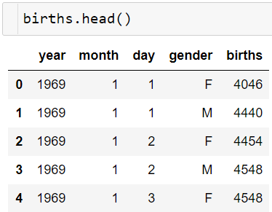
Practice: Birthrate Data
Let's take a look at the freely available data on births in the United States, provided by the Centers for Disease Control (CDC)
url = ‘https://raw.githubusercontent.com/jakevdp/data-CDCbirths/master/births.csv’
births = pd.read_csv(url)
Let's add a decade column, and take a look at male and female births as a function of decade.
Total birth in the quarters at male and female births
…..

Slide 21
Dataframes and Data Cleaning Tasks
Dataframes and Data Cleaning Tasks The specific tasks that you need to perform depend on the structure and contents of a dataset. In general, you will perform a workflow with the following steps (not necessarily always in this order), all of which can be performed with a Pandas DataFrame:
read data into a DataFrame
display top of DataFrame
display column data types
display non-missing values
replace NA with a value
iterate through the columns
statistics for each column
find missing values
total missing values
percentage of missing values
sort table values
print summary information
columns with > 50% missing values
rename columns

Slide 22
Visualize data with pandas
Method: ‘plot()’
Kind: The kind of plot to produce:
‘line’ : line plot (default)
‘bar’ : vertical bar plot
‘barh’ : horizontal bar plot
‘hist’ : histogram
‘box’ : boxplot
‘kde’ : Kernel Density Estimation plot
‘density’ : same as ‘kde’
‘area’ : area plot
‘pie’ : pie plot
‘scatter’ : scatter plot (DataFrame only)
‘hexbin’ : hexbin plot (DataFrame only)
df = pd.pivot_table(data=birth,
index = 'year',
columns= 'gender',
values='births',
aggfunc='sum')
df.plot(kind = 'line',title='Title-1', xlabel='X-axis', ylabel='Y-axis')
df.plot(kind='bar',title='Title-2', xlabel='X-axis', ylabel='Y-axis')
df.plot(kind='hist',title='Title-3', xlabel='X-axis', ylabel='Y-axis')
df.plot(kind='box',title='Title-4', xlabel='X-axis', ylabel='Y-axis')
df.plot(kind='scatter', x='F', y='M',title='Title-5', xlabel='X-axis', ylabel='Y-axis')
Ref: https://pandas.pydata.org/docs/reference/api/pandas.DataFrame.plot.html#pandas.DataFrame.plot

